Slide 1

HISTOPATHOLOGICAL IMAGE ANALYSIS FOR ORAL SQUAMOUS CELL CARCINOMA CLASSIFICATION
Team Members:
L Vishal – vishal.e0119010@sret.edu.in
M Sathishkumar – sathishkumar.e0119052@sret.edu.in
Guided by:
Dr. Jayanthi Ganapathy, Assistant Professor, Sri Ramachandra Faculty of Engineering and Technology
jayanthig@sret.edu.in
SRI RAMACHANDRA FACULTY OF ENGINEERING & TECHNOLOGY

Slide 2

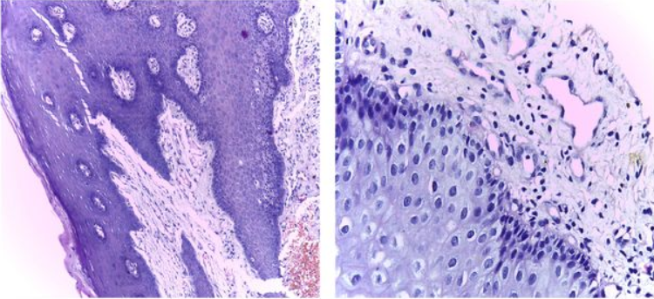
ORAL SQUAMOUS CELL CARCINOMA
Oral squamous cell carcinoma (OSCC) is a subset of head and neck squamous cell carcinoma (HNSCC), the 7th most common cancer worldwide, and accounts for more than 90% of oral malignancies.

Slide 3
PROBLEM STATEMENT
Oral cancer is one of the 10 most common cancers in the world.
The average age of most people diagnosed with these cancers is 63, but they can occur in young people.
Just over 20% (1 in 5) of cases occur in patients younger than 55.
Timely diagnosis and treatment is key to patient’s complete recovery
Need of a system that is rapid, cost effective and accurate

Slide 4
OBJECTIVE OF STUDY
For detection of oral tumors, a histopathology test is essential. There are various shortcomings for this procedure as all cancer cells and tissues can also have multiple appearances, and many other objects in cells have the same hyperchromatic features, which make identification difficult.
We aim to address this problem by using deep learning models because this approach tries to learn high-level features from data in an incremental manner, which might not be visible to our naked eyes like poorly illuminated, overstained images.

Slide 5
DATASET DESCRIPTION
Dataset Link https://www.sciencedirect.com/science/article/pii/S2352340920300081#:~:text=The%20repository%20is%20composed%20of,(OSCC)%20in%20100x%20magnification
The repository is composed of 1224 images divided into two sets of images with two different resolutions.
First set consists of 89 histopathological images with the normal epithelium of the oral cavity and 439 images of Oral Squamous Cell Carcinoma (OSCC) in 100x magnification.
The second set consists of 201 images with the normal epithelium of the oral cavity and 495 histopathological images of OSCC in 400x magnification.
Image Dimension - 96 x 96 x 3

Slide 6
PROPOSED METHODOLOGY
For training, we augment normal epithelium cell images as availability of different class images is imbalanced
Approximately 10% of the data is used for cross validation and rest is used for training.
We are using a series of CNN layers for modelling the data. It creates a better feature representation of the image for better accuracy.
Also, we compared different CNN architectures and benchmarked the performance metrics.

Slide 7
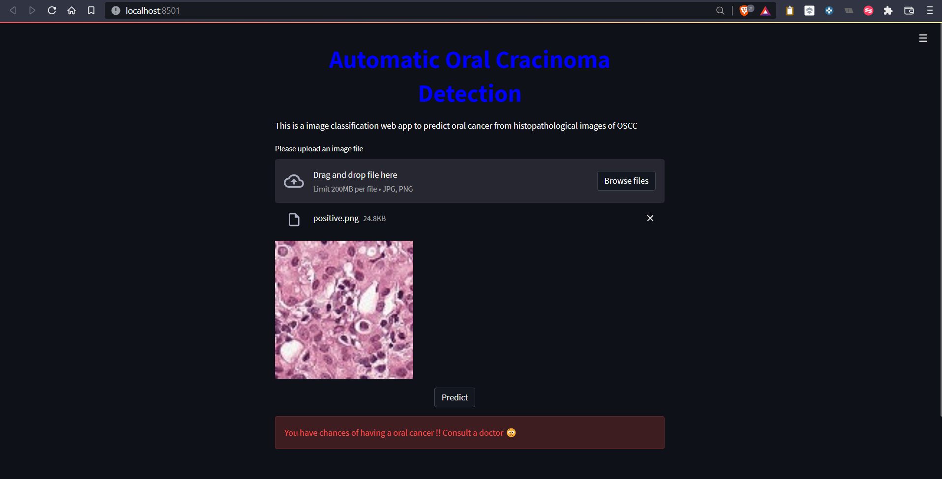
WEB APP LOOKUP

Slide 8
THANK YOU

